Slide 1
Sangoma Monthly Reseller
Webinar Series
Let’s Build a Strong Partnership
Presented by:
Tom Uhteg &
Mark Carson
Office: Amherst, New York
Contact Us: 1-800-398-8647
Notes:
Monthly series, we’ll include some quick intro info about the program for those of you that are new or not yet signed up
These are designed to just be a brief update for our reseller community. This will be pretty quick. I don’t expect many in the series to go over 15-30 minutes.
Please use the chat function to ask questions, I’ll try to answer them along the way or at least at the end.
If I can’t answer it during this webinar, I’ll get back to you of course.

Slide 2
Reseller Benefits
VoIP Rental Program
our Device as a Service (DaaS) rental program gives your customers the widest variety of VoIP Products for a low monthly payment!
Hardware & Provisioning
featuring over 60 manufacturers that offer over 16,000 products and the ability to provision for you!
CloudSpan MarketPlace
a single place to shop various VoIP service providers - build up your MRR and receive discounts on hardware selling through VoIP Supply
Fulfillment
provisioning and professional services from multiple warehouse locations in North America; providing real-time access to manage your projects from order through delivery
Refresh & Reclaim
offering certified reconditioned devices at a fraction of the cost plus offering an outlet for selling off used and excess VoIP equipment
Since 2002 VoIP Supply
has delivered unparalleled service and expertise to
over 125,000 customers worldwide.

Slide 3
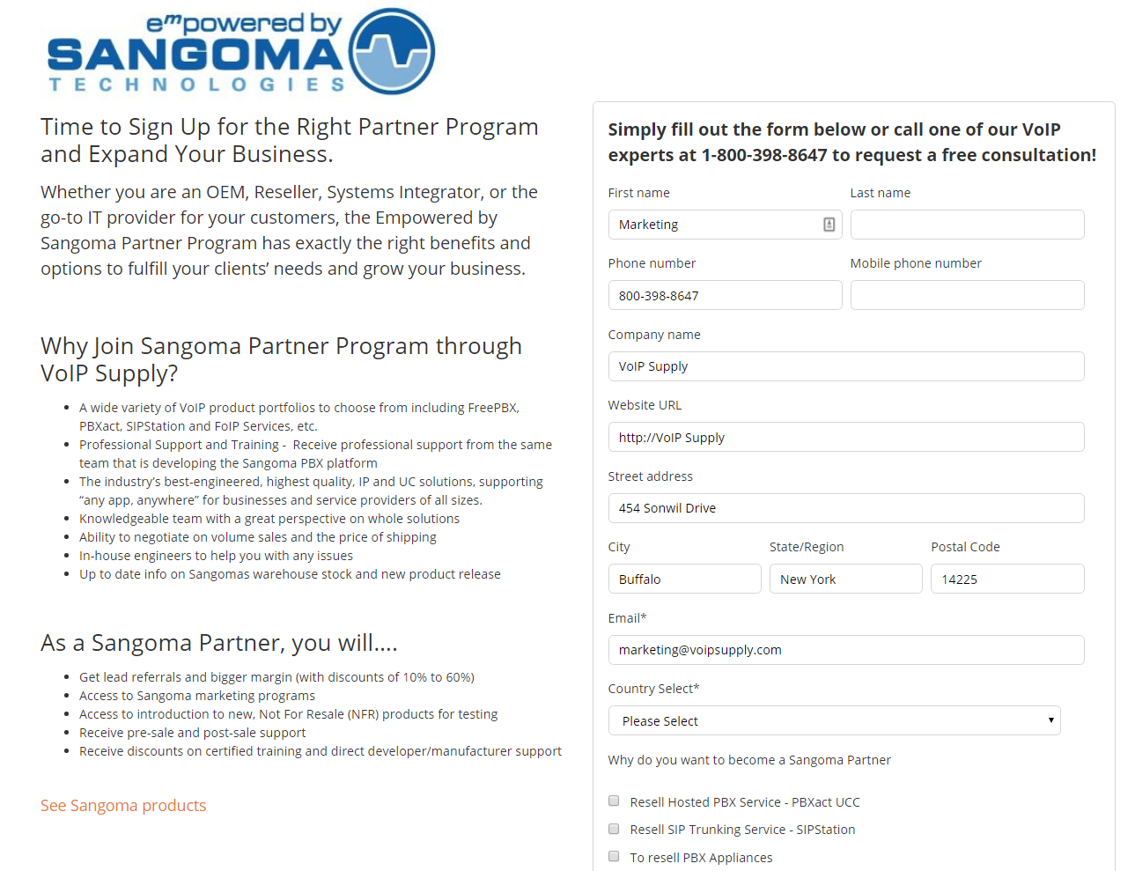
Sign-Up To Be a Sangoma Reseller
How Do I Sign -Up?
Visit our website and fill out the form.
https://www.voipsupply.com/sangoma-partner
Someone from our Sales and Marketing Team will be in touch with you!
Mark Carson from Sangoma will then help you with the onboarding process so you can be an official Sangoma Reseller!
Notes:
Simply visit our website and click on the sangoma brand page, then go to Sangoma Reseller Program to sign up to be an official Sangoma Reseller. Someone from our Sales and Marketing Departments will contact you and Mark Carson from Sangoma will help with the onboarding process.

Slide 4
Join Our Team
Become a VoIP Supply Partner
Exclusive Pricing Through VoIP Supply!
Opportunity Support – Consulting & Solution Design
Tom Uhteg
Solutions Consultant
(716) 531-4265
tuhteg@VoIPSupply.com
Notes:
Exclusive pricing to our resellers- including h/w rebates if you are selling both hardware and services though us.
We are here to help you sell solutions to you clients
I am happy to onboard you.
Even if it’s not me and you remember us a few days from now, call us with our opportunities and we can support you… use our team and of course we can leverage our vendor relationships for you.

Slide 5
SANGOMA TECHNOLOGIES How to Increase Your Revenue with Sangoma Products!
Presented By:
Mark Carson
Channel Account Manager
mcarson@sangoma.com
920-215-0279

Slide 6
Contents
Sangoma FreePBX and PBXact
How to Save Money with PBXact - Cost Analysis
Sangoma Portal - Marketing Resources
Q&A

Slide 7
FreePBX
Notes:
The first platform I’m going to talk about is FreePBX, so first things first… the Free in FreePBX Stands for Freedom. The platform is fully featured and configurable to provide you the Freedom to configure the system to fit your end users needs… it also just happens to be a free of charge, open source platform. So open source is the software distribution method, meaning that anyone can view the code that builds the platform, typically the more eyes on code the more resilient it becomes in both features, security and optimization of the platform.

Slide 8
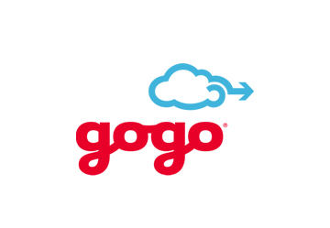
Some of Our FreePBX / PBXact Customers & Partners...
Notes:
So FreePBX is the Worlds Most Popular PBX Platform. It’s now in use in over 225 countries and Territories (US and Canada ranking 1st and 2nd globally). I have to say 225 territories, as there are only about 180 countries. So how prevalent is FreePBX… I can’t share the exact number of installations, or number of installs per day, but if we take a look at just website rankings on Alexa we can reveal some insights into the popularity of the platform.

Slide 9
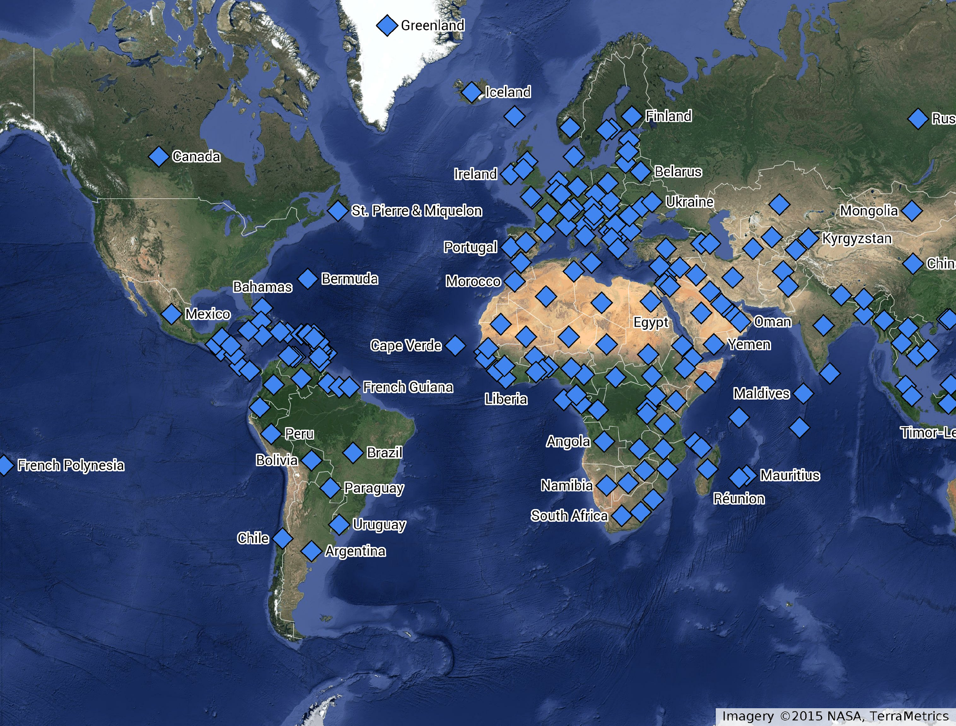
World's Most Prevalent Phone System
Millions of production installations
Tens of Thousands of installs per month
In use in over 225 countries
Notes:
So FreePBX is the Worlds Most Popular PBX Platform. It’s now in use in over 225 countries and Territories (US and Canada ranking 1st and 2nd globally). I have to say 225 territories, as there are only about 180 countries. So how prevalent is FreePBX… I can’t share the exact number of installations, or number of installs per day, but if we take a look at just website rankings on Alexa we can reveal some insights into the popularity of the platform.

Slide 10
FreePBX – Open Source Full-featured PBX, with Add-ons
Call Features | Business Features | Telephony support | Management | UC Features | Feature Add-ons ($)
Three Way Calling Voice Mail Voicemail-to-Email Caller ID Call Transfer Call Recording Do Not Disturb Call Forwarding Call Waiting Call History Call Detail Records Call Event Logging Speed Dials Caller Blacklisting Paging/Intercom Call Screening | Support for video calling Secure Communications (SRTP/TLS) Directory Announcements, Text to Speech Calling Queues (ACD/IVR) Flexible time-based call routing Built in conference bridge/service Fax-to-email Hunt/Ring groups Music-on-Hold Voicemail blasting Find me/Follow me Personal IVRs Wake-up calls | SIP, IAX2 PRI, T1, E1, J1, Analog, ISDN, GSM with add on CT cards Integrated Sangoma IP-Phone Support Voice Gateways Softphone support Door phones Overhead paging Strobe alerts Paging Gateways Failover devices Desktop and mobile phones | System Upgrades System dashboards Bulk import End-Point Manager (free with Sangoma Phones) Localization Backup and restore Caller ID lookup Custom Destination Administration Web-based config file management System Recording GUI controls for DNS, Network Setting VPN / Firewall ($) High Availability ($) | UCP XMPP Pro Zulu UC ($) CRM Link ($) Phone Apps (free with Sangoma phones) Conference Bridges Voicemail-to-Email Fax-to-email Find me/Follow me VPN ($) Web Call Back ($) | Appointment Rem. Broadcast Dialer Caller ID Mgmt Call Recordings Rp Class of Service Conference Pro CRM Link End Point Manager Extension Routing Fax Pro Outbound Call Lim. Paging Pro Park Pro Phone Apps PINSet Pro Queue Reports Queue Stats System Admin Pro Virtual Queue Pro Voicemail Reports Voicemail Notify Web Call Back
Zulu UC ($)
CRM Link ($)

Slide 11
PBXact
Notes:
Suggest a break here.

Slide 12
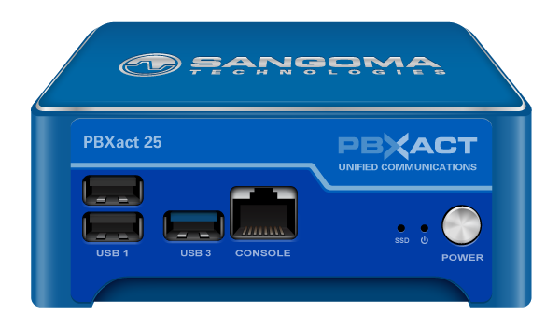
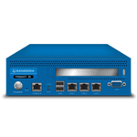
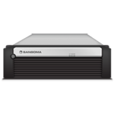
Appliances
Description | FreePBX | PBXact
25 – 25 USER PBXact Only 40 – 40 user,30 calls | N/A $695 | $645 $845
60 – 60 user, 30 calls | $845 | $995
75 – 75 user, 30 calls | $845 | $995
100 – 100 user, 30 calls | $1,195 | $1,495
400 – 400 user, 120 calls | $1,995 | $2,995
400 – Dual Power | $2,495 | $3,495
1000 – 1000 user, 300 calls | $5,995 | $7,295
2000 – 2000 user, 300 calls | NA | $12,995
5000 – 5000 user, 1500 calls Software Only PBXact | NA NA | $24,995 $800
Notes:
The typical way users acquire PBXact licenses is by purchasing a Sangoma appliance pre-loaded with PBXact, if you look at the price difference at MSRP between a system loaded with FreePBX and one loaded with PBXact you will see that it’s a “no brainer” to choose the PBXact offering.

Slide 13
PBXact Simple Setup Configuration Wizard
Simple steps to Configure your PBX
System Settings
Sangoma Phone Provisioning
Sangoma Phone Apps
Extension Range
Extension Details
Inbound Call Routing
IVR/Auto-Attendant Setup
Fax Setup
Our guarantee:
10 Users in 10 Minutes
Fully featured and ready to go
Notes:
Setup of PBXact is simple with a simple setup wizard that walking you through your initial configurations.

Slide 14
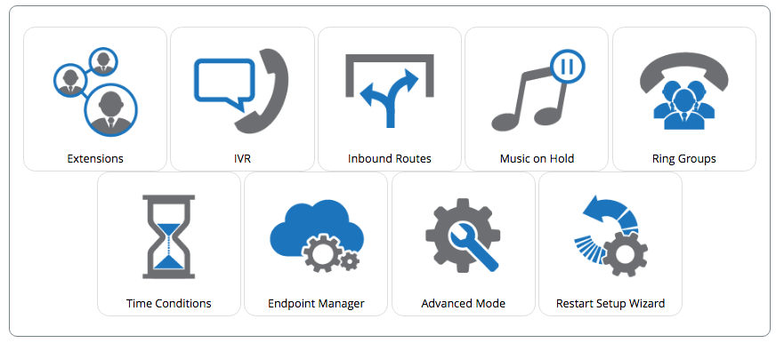
Simple Configuration Dashboard
Simple view to manage most common task
If More Control is needed switch to Advanced Mode
Notes:
With PBXact we have also created a simple configuration dashboard only exposing the most popular settings which makes it easy for novice users to manage the system

Slide 15
Differences Between FreePBX & PBXact
FreePBX – Open source
Stack of CentOS, MySQL, Asterisk, FreePBX, +++
Dozens of modules and upgrades every day
No Software Warranty
PBXact – Commercial Version
Same Code base as FreePBX
Hardened, more QA, version control
10 steps Simple Configuration Wizard
More features and software in base system
Includes most Add-ons, more value for the money
Annual Software Maintenance Plans + SLAs
Software Warranty provided

Slide 16
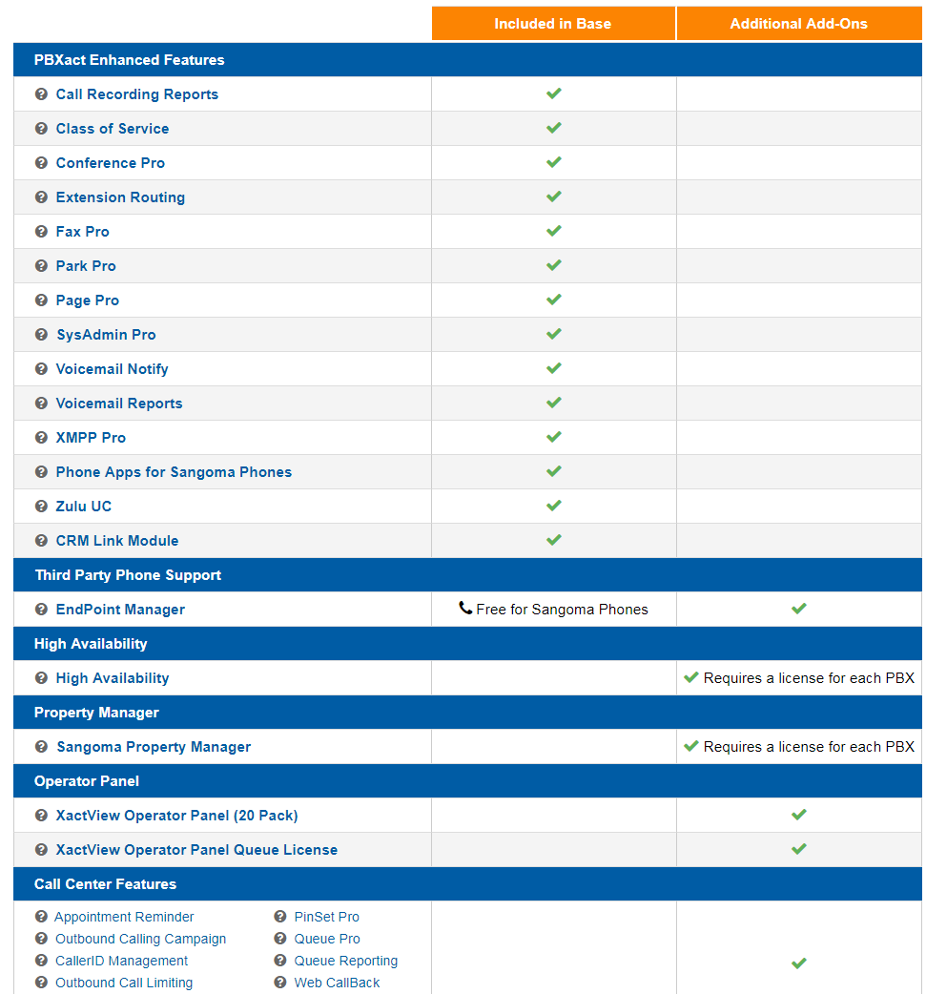
PBXact – with Add-Ons
Included in Base
(Value > $1,500)
✔
✔
✔
✔
✔
PBXact 25 Appliance
✔
✔
✔
✔
✔
✔
✔
✔
✔
✔
✔ Included Free
with
Sangoma Phones

Slide 17
PBXact Expanded Features
Call Recording Reports – Advanced call recording capabilities & archiving features
Class of Service – Granular control of user and system permission
Conference Pro – End User Conference room management and control
EndPoint Manager – Auto provision & Sangoma Phones management
Fax Pro – Outbound Faxing for End Users
Paging Pro – Valet style paging, scheduled pages, outbound notifications
Phone Apps – Suite of phone side PBX applications
User Control Panel Device Management – End user phone button control
Voicemail Notify – List based voicemail notifier, with reporting
Voice Mail Reports – Advanced voicemail administration and monitoring
Notes:
So, above the basic FreePBX feature set we tightly run quality Assurance on the entire PBXact platform ensure only the most stable versions are released into the system, and we include additional functionality such as class of service calling reports, conference prom fax pro paging pro voicemail notify and reports as standard in PBXact.

Slide 18
FreePBX vs PBXact Total Cost of Ownership
FreePBX is a basic PBX system that is open source
PBXact is a full featured PBX system with higher level features
FreePBX has the ability to be a full featured system with al a carte commercial modules
PBXact comes with almost everything “baked” into the product
A FreePBX system with all the feature set of PBXact will cost your customer more over time
Notes:
So, above the basic FreePBX feature set we tightly run quality Assurance on the entire PBXact platform ensure only the most stable versions are released into the system, and we include additional functionality such as class of service calling reports, conference prom fax pro paging pro voicemail notify and reports as standard in PBXact.

Slide 19
FreePBX vs PBXact Value
FreePBX
PBXact
FreePBX 100 System configured as a PBXact comes stocked with applications
Extension routing, SysAdmin Pro, Phone Apps, CRM Link, Call Recording Reports, Conference Pro, Class of Service, Paging Pro, Park Pro, Fax Pro, Voicemail Notify, Voicemail Reports and Zulu Clients first year support
End-user cost $4.151.00
Annual Renewals $1.689.12
PBXact 100 Systems with appliance and one year support contract, all ala carte items are included
End-use cost $1,645.00
Annual update for support only $150
Notes:
So, above the basic FreePBX feature set we tightly run quality Assurance on the entire PBXact platform ensure only the most stable versions are released into the system, and we include additional functionality such as class of service calling reports, conference prom fax pro paging pro voicemail notify and reports as standard in PBXact.

Slide 20
FreePBX vs PBXact Over 5 years
PBXact
FreePBX
First year system cost: $1,645.00
Years 2-5 support cost: $150.00
5 year total cost: $2,245.00
First year system cost: $ 4,151.00
Years 2-5 renewal cost: $1,689.12
5 Year Total cost: $10,907.48
Notes:
So, above the basic FreePBX feature set we tightly run quality Assurance on the entire PBXact platform ensure only the most stable versions are released into the system, and we include additional functionality such as class of service calling reports, conference prom fax pro paging pro voicemail notify and reports as standard in PBXact.

Slide 21
FreePBX is Great… So Why PBXact?
CUSTOMER RESELLER
While there is no charge for FreePBX, there is an extra cost to get it to do everything a customer wants.
FreePBX requires some knowledge and experience to set it up and have it run smoothly.
PBXact is a finished product that allows you to concentrate on what your business, not on a DYI phone system.
You have the option to sell a product with a good margin, and add still add support. While saving the customer year over year.
It requires less time to set the system up and get the client running using the tools available in PBXact.
The customer requires less overall attention with a system that runs smoothly meaning less expenses on your part.

Slide 22
Sangoma Marketing Portal
Notes:
Suggest a break here.

Slide 23
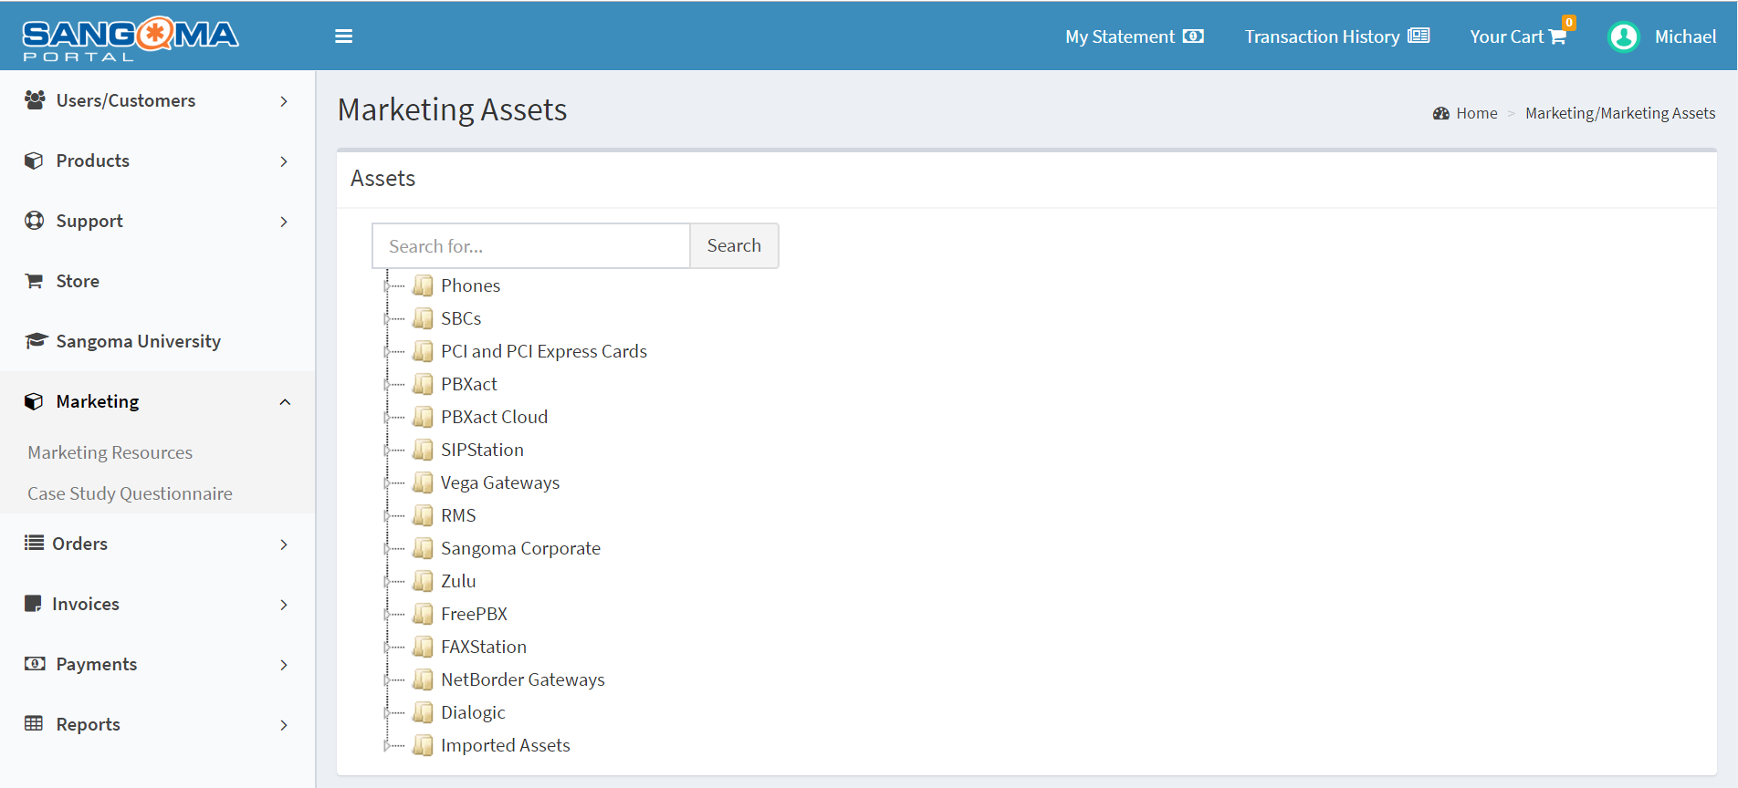
Sangoma Partner Portal - Marketing Resources
How do I access the Marketing
Resources in the Sangoma Portal?
Marketing
Marketing Resources
Ease of acquisition for
product information!
You have access to:
Banners
Case Studies
Datasheets
Logos
Product Photos
White Paper
and so much more!

Slide 24
Sangoma Partner Portal - Marketing Resources
Ease of acquisition for
product information!

Slide 25
Q & A
Notes:
Where are your biggest challenges wi

Slide 26
Join Our Team
Tom Uhteg
Solutions Consultant
(716) 531-4265
Tuhteg@VoIPSupply.com
Mark Carson
Channel Account Manager
(920) 215-0279
mcarson@sangoma.com
Notes:
Exclusive pricing to our resellers- including h/w rebates if you are selling both hardware and services though us.
We are here to help you sell solutions to you clients
I am happy to onboard you.
Even if it’s not me and you remember us a few days from now, call us with our opportunities and we can support you… use our team and of course we can leverage our vendor relationships for you.

