Slide 1
VoIP Supply Reseller
Webinar Series
Let’s Build a Strong Partnership
Office: Amherst, New York
Contact Us: 1-800-398-VoIP
Presented by:
Brian Hyrek
Notes:
Monthly series, we’ll include some quick intro info about the program for those of you that are new or not yet signed up
These are designed to just be a brief update for our reseller community. This will be pretty quick. I don’t expect many in the series to go over 15-30 minutes.
Please use the chat function to ask questions, I’ll try to answer them along the way or at least at the end.
If I can’t answer it during this webinar, I’ll get back to you of course.

Slide 2
Reseller Benefits
NEW VoIP Rental Program
our Device as a Service (DaaS) rental program gives your customers the widest variety of VoIP Products for a low monthly payment!
Hardware & Provisioning
featuring over 60 manufacturers that offer over 16,000 products and the ability to provision for you!
CloudSpan MarketPlace
a single place to shop various VoIP service providers - build up your MRR and receive discounts on hardware selling through VoIP Supply
Fulfillment
provisioning and professional services from multiple warehouse locations in North America; providing real-time access to manage your projects from order through delivery
Refresh & Reclaim
offering certified reconditioned devices at a fraction of the cost plus offering an outlet for selling off used and excess VoIP equipment
Since 2002 VoIP Supply
has delivered unparalleled service and expertise to
over 125,000 customers worldwide.

Slide 3
Promotions
Spring Promotion! Earn Money!
On top of your existing discount levels
Earn up to:
PBXact
Earn up to 4 x MRR on 36 mo. contracts
Earn up to 2 x MRR on 12 mo. contracts
SIPStation
Earn up to 2 x MRR on 36 mo. contracts
Earn up to 1 x MRR on 12 mo. Contracts
Starts now
For new sites
Running all the way to March 31st 2019!
Sangoma Reseller SPIFFs
SPIFF requires a current Sangoma Partner Agreement and will be
issued after the customer’s first full paid service invoice.

Slide 4
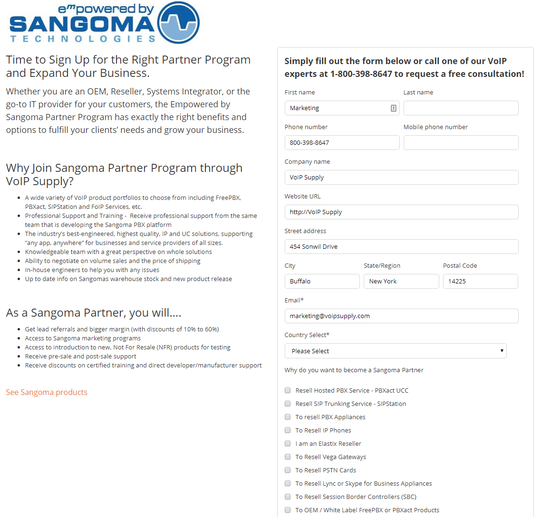
Sign-Up To Be a Sangoma Reseller
How Do I Sign -Up?
Visit our website and fill out the form.
Someone from our Sales and Marketing Team will be in touch with you!
Mark Carson from Sangoma will then help you with the onboarding process so you can be an official Sangoma Reseller!
Notes:
Simply visit our website and click on the sangoma brand page, then go to Sangoma Reseller Program to sign up to be an official Sangoma Reseller. Someone from our Sales and Marketing Departments will contact you and Mark Carson from Sangoma will help with the onboarding process.

Slide 5
Join Our Team
Become a VoIP Supply Partner
Exclusive Pricing Through VoIP Supply!
Opportunity Support – Consulting & Solution Design
Brian Hyrek
Account Manager
(716) 531-4318
Bhyrek@VoIPSupply.com
Notes:
Exclusive pricing to our resellers- including h/w rebates if you are selling both hardware and services though us.
We are here to help you sell solutions to you clients
I am happy to onboard you.
Even if it’s not me and you remember us a few days from now, call us with our opportunities and we can support you… use our team and of course we can leverage our vendor relationships for you.

Slide 6
Sangoma
Reselling Cloud Services
Presented By:
Mark Carson
Channel Account Manager
mcarson@sangoma.com
920-215-0279

Slide 7
Contents
About Partner webinars
Intro to Sangoma’s Cloud Services
Agent vs Reseller model
Next Partner Webinars
Q&A

Slide 8
About Partners Webinars
Will be held 2nd Wednesday of every month!
20-30 minutes tops
Quick updates on topics that help you do more business
This one will be about Reselling our Cloud Services
Your ideas welcome for future topics

Slide 9
Cloud PBXact – Hosted PBX Service
Full Extensions – Provides a Trunk channel and Extension
Get 3000 minutes of calls per month per trunk channel
Lite Extensions – Extension only
Number porting
Full fledged PBXact feature set including Zulu Collaboration
Pricing per mo.
Full Ext (MSRP)
Month to Month @ $24.95
12 months @ $22.95
36 months @ $19.95
Lite Extension
All levels @ $8.95
Partners can purchase with discounts or get monthly commissions.
Discounts and Commissions Levels vary depending on your partner status (Bronze or Silver)
https://cloud.pbxact.com/

Slide 10
SIPStation – SIP Trunking Service
Purchase SIP Trunking channels
3000 minutes bundle per trunk channels
Free 21 day trials
Number porting
Integrates directly with FreePBX and PBXact, but also other PBXs
Pricing (MSRP)
Month to Month @ $24.99
12 months @ $22.99
36 months @ $19.99
Partners can purchase with discounts or get monthly commissions.
Discounts and Commissions Levels vary depending on your partner status (Bronze or Silver)
https://www.sipstation.com/

Slide 11
FAXStation – Fax over IP Service
Fail safe Fax over IP Service
High Volume Faxing @ $24.99 per month
Low Volume Faxing @ $9.95 per month
Optional analog gateway for legacy faxes
Number porting
Online portal to track faxes
Purchased on either Cloud PBXact or SIPStation web sites
Partners can purchase with discounts or get monthly commissions.
Discounts and Commissions Levels vary depending on your partner status (Bronze or Silver)

Slide 12
Agent vs Reseller Model
Reseller
You buy from us, we invoice you
You resell, invoice your end user customer
Agent
You bring the customer to us
We invoice the customer
We pay you a monthly commission
Make sure you have the end users sign up with your custom URL, otherwise we have no way of paying your commissions

Slide 13
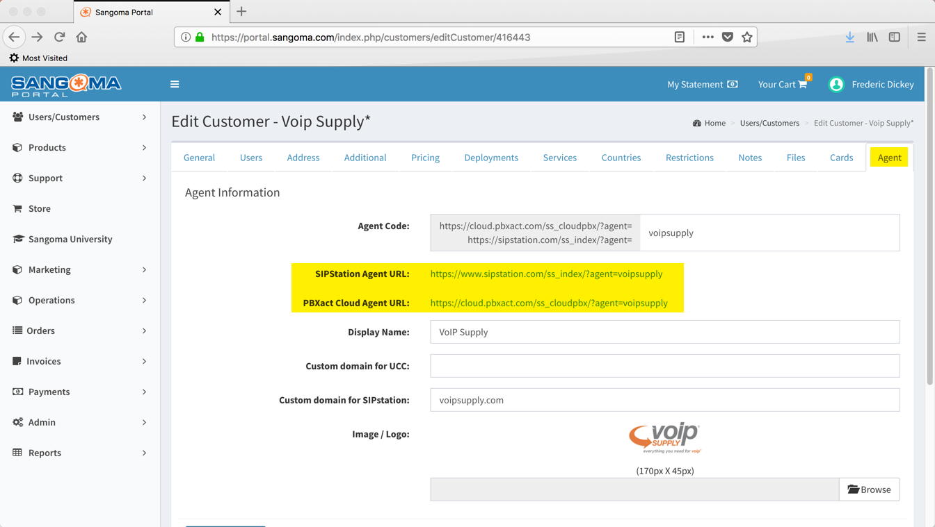
Custom URL example – make sure it is populated!

Slide 14
Next Webinars
Monthly Webinars (2nd Wednesday of every month)
We have a long list of topics
But I want to hear for you
What topics should we cover?

Slide 15
How To Win a $50 Gift Card to Amazon!
$50 Amazon gift card is only eligible to individuals who attended today’s webinar
First 4 Deals registered with a 1 or 3 year contract within the next 90 days
You have 4 chances to win if YOU register all 4 deals first!
Good luck!

Slide 16
Q & A

Slide 17
Join Our Team
Brian Hyrek
Account Manager
(716) 531-4318
Bhyrek@VoIPSupply.com
Notes:
Exclusive pricing to our resellers- including h/w rebates if you are selling both hardware and services though us.
We are here to help you sell solutions to you clients
I am happy to onboard you.
Even if it’s not me and you remember us a few days from now, call us with our opportunities and we can support you… use our team and of course we can leverage our vendor relationships for you.

